Slide 1
APA-Guidelines

Slide 2
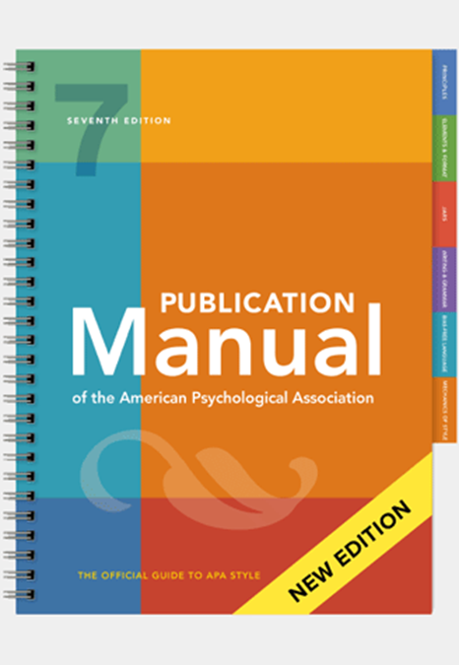
APA-GUIDELINES
Compact manual on formatting your paper and citing sources according to APA-7 referencing available via:
https://libguides.csudh.edu/citation/apa-7
Notes:
The rules on referencing in social sciences have been drafted by the American Psychological Associacion and are listed in the Publication Manual (available from the library).

Slide 3
APPLYING APA-GUIDELINES Assessment criteria Rubric
References in the text:
have the correct notation (APA-7)
are in the right place (clear where the information comes from)
References in the reference list:
have the correct nation (APA-7)
are listed in the correct order
The text does not contain references that are not included in the reference list or vice versa
The text lay-out is conform to the APA-7 (student paper) style

Slide 4
Pitfalls APA
Not correctly applying the APA rules (tiny errors in punctuation, case or otherwise)
How often and where to place a reference?
Text layout not according to APA-student paper style
Overview of APA-rules:
https://libguides.csudh.edu/citation/apa-7
Notes:
It’s important to stick to the APA rules (to the letter!) Losing marks over these is just such a waste of effort.
Students often fail to correctly apply the APA Guidelines when writing a report. This can have one of two causes: either they have been sloppy, or they aren't aware of the correct way of doing it.
Another aspect is that students find it hard to determine where best to insert the reference and how often to repeat it. In principle, you, the author, should ensure that there can be no doubt as to the source of your information, but to really get a feel for how to do it, students are advised to pay attention to how sources are cited in scientific literature.

Slide 5
In-text references
Number of authors | Parentheses | Narrative
1 | (Johnson, 2020) | Johnson (2020)
2 | (Smith & Jones, 2019) | Smith and Jones (2019)
3 or more | (Carlson et al., 2018) | Carlson et al. (2018)
Multiple articles at once: Alphabetical order, separated by;
Example:
“From several studies it can be concluded …. (Asendorpf & Van Aken, 1999; Meeus et al., 2011; Van Leeuwen et al., 2004).”

Slide 6

Point of attention in-text references
Research has suggested that the use of difficult words can lead to the author being considered not very intelligent (Oppenheimer, 2006).
Research has suggested that the use of difficult words can lead to the author being considered not very intelligent. (Oppenheimer, 2006)
INCORRECT
Notes:
The reference belongs to the sentence, so should be inserted before the full stop. The sentence doesn't end until after the reference!

Slide 7
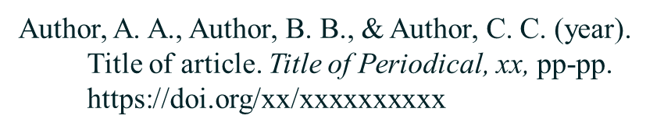
APA reference list
General principle: Who, When, What, Where
Different lay-outs depending on type of source (article, book, website etc)
Reference list is sorted alphabetically
Indentation for second and subsequrent lines of reference
Example journal article:

Slide 8
Point of attention reference list
Haidt, J., Koller, S. H., & Dias, M. G. (1993). Affect, culture, and
morality, or is it wrong to eat your dog? Journal of Personality and Social Psychology, 65 (4), 613-628.
Notes:
We don't transpose the capitals from the title of the article. Just make a proper sentence. An exception is the use of a capital following a colon.

Slide 9
Point of attention reference list
Haidt, J., Koller, S. H., & Dias, M. G. (1993). Affect, culture, and morality, or is it wrong to eat your dog? Journal of Personality and Social Psychology, 65 (4), 613-628.
Notes:
Capitals from the title of the journal, however, are transposed, as you would with a person's name.

Slide 10
How often and where to place a reference?
It is important to provide correct references for any information coming from another source
Use references to substantiate ideas/connections/conclusions
Cite as early as possible (in first sentence in which it is relevant)
Note:
In paragraphs that contain one overall instance of paraphrased information, “cite the source in the first sentence in which it is relevant and do not repeat the citation in subsequent sentences as long as the source remains clear and unchanged” (American Psychological Association, 2020, p. 254).

Slide 11
Tips Applying APA-guidelines
Follow the APA-guidelines by the letter!
All the information in your report should be backed-up by a reference
Mainly use primary sources (empirical articles)
Search for the original source when you come across an interesting point in another source
Format your paper according to APA-7 student paper style (see sample reports on Canvas)
Have a look at the articles you've read for your report:
- How often do authors refer to other sources?
- Where are the references placed?

